Slide 1

The Generative AI Revolution: A Month-Long AI Exploration
Level 2 | Apr 2024 | Week 1 Day 1

Slide 2

π
Runnables
May 2024
π

Slide 3

π
Tools We will cover?

Slide 4
π
Runnables
Basics ?
typeDictionary
Pydantic
JsonOutputParser
StructuredoutputParser
Pydanticoutparser
π

Slide 5
π
Runnable
Langchian

Slide 6
π
Runnables type
Task specfic Runnables
Runnables premitive
Notes:
Content: https://www.linkedin.com/pulse/chunking-strategies-ai-data-kash-kashyap-0lghe/

Slide 7
π
Notes:
Content: https://www.linkedin.com/pulse/chunking-strategies-ai-data-kash-kashyap-0lghe/

Slide 8
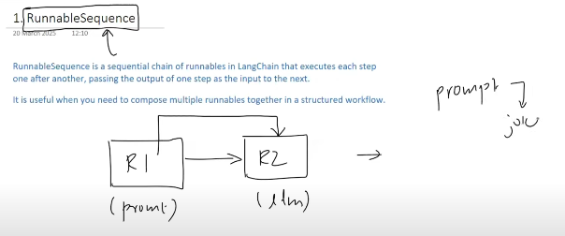
π
Notes:
Content: https://www.linkedin.com/pulse/chunking-strategies-ai-data-kash-kashyap-0lghe/

Slide 9
π
from dotenv import load_dotenv
from langchain_google_genai import ChatGoogleGenerativeAI
from langchain_core.prompts import PromptTemplate
from langchain_core.runnables import RunnableSequence
from langchain_core.output_parsers import StrOutputParser
load_dotenv()
model=ChatGoogleGenerativeAI(model="gemini-2.0-flash", temperature=0)
parser=StrOutputParser()
temp=PromptTemplate(
template="generate a joke about {topic}",
input_variables=[“topic” ])
chain=temp | model | parser
res = chain.invoke({ “topic”: “monkey”})
print(res)
Notes:
Content: https://www.linkedin.com/pulse/chunking-strategies-ai-data-kash-kashyap-0lghe/

Slide 10
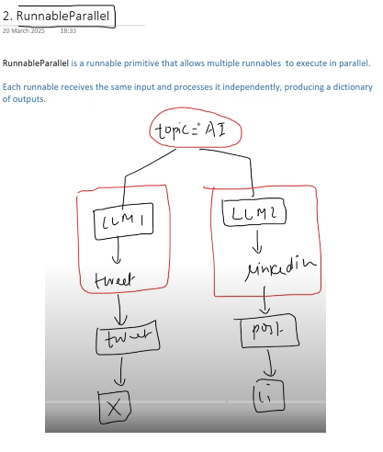
π
RunnableParallel
Notes:
Content: https://www.linkedin.com/pulse/chunking-strategies-ai-data-kash-kashyap-0lghe/

Slide 11
π
from dotenv import load_dotenv
from langchain_google_genai import ChatGoogleGenerativeAI
from langchain_core.prompts import PromptTemplate
from langchain_core.runnables import RunnableSequence, RunnableParallel
from langchain_core.output_parsers import StrOutputParser
load_dotenv()
model=ChatGoogleGenerativeAI(model="gemini-2.0-flash", temperature=0)
parser=StrOutputParser()
promp1=PromptTemplate( template="generate a joke about {topic}", input_variables=[“topic” ])
prompt2=PromptTemplate( template="generate a joke about {topic}", input_variables=[“topic” ])
parallel_chain=RunnableParallel({
"tweet“ : RunnableSequence(prompt1,model,parser),
"LinkedIn": RunnableSequence(prompt1,model,parser)
})
print(parallel_chain.invoke({"topic":"AI"}))
{
'tweet': 'AI is rapidly evolving, and the possibilities are endless! ',
'linkkedin': 'AI is rapidly evolving, and the possibilities are endless!'
}
Notes:
Content: https://www.linkedin.com/pulse/chunking-strategies-ai-data-kash-kashyap-0lghe/

Slide 12
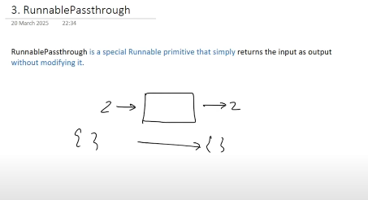
π
RunnablePassthrough
Notes:
Content: https://www.linkedin.com/pulse/chunking-strategies-ai-data-kash-kashyap-0lghe/

Slide 13
π
from dotenv import load_dotenv
from langchain_google_genai import ChatGoogleGenerativeAI
from langchain_core.prompts import PromptTemplate
from langchain_core.runnables import RunnableSequence, RunnableParallel
from langchain_core.output_parsers import StrOutputParser
load_dotenv()
model=ChatGoogleGenerativeAI(model="gemini-2.0-flash", temperature=0)
chain=RunnablePassthrough()
res=chain.invoke(777)
print(res)
Notes:
Content: https://www.linkedin.com/pulse/chunking-strategies-ai-data-kash-kashyap-0lghe/

Slide 14
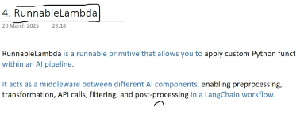
π
Notes:
Content: https://www.linkedin.com/pulse/chunking-strategies-ai-data-kash-kashyap-0lghe/

Slide 15
π
from dotenv import load_dotenv
from langchain_google_genai import ChatGoogleGenerativeAI
from langchain_core.prompts import PromptTemplate
from langchain_core.runnables import RunnableLambda
from langchain_core.output_parsers import StrOutputParser
load_dotenv()
model=ChatGoogleGenerativeAI(model="gemini-2.0-flash", temperature=0)
def toUpperCase(x:str):
return x.upper()
chain=RunnableLambda(toUpperCase)
res=chain.invoke("hello world")
print(res)
Notes:
Content: https://www.linkedin.com/pulse/chunking-strategies-ai-data-kash-kashyap-0lghe/

Slide 16
π
Notes:
Content: https://www.linkedin.com/pulse/chunking-strategies-ai-data-kash-kashyap-0lghe/

Slide 17
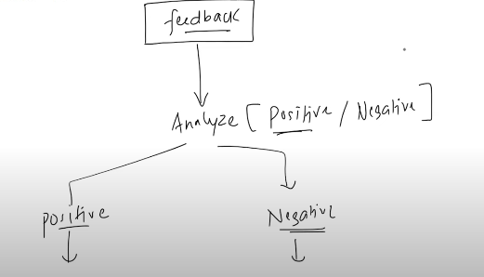
π
Notes:
Content: https://www.linkedin.com/pulse/chunking-strategies-ai-data-kash-kashyap-0lghe/

Slide 18
π
Notes:
Content: https://www.linkedin.com/pulse/chunking-strategies-ai-data-kash-kashyap-0lghe/

Slide 19


π
Q & A

